Slide 1
Race Condition
Semester Project Final
13011203 Son YoungDuk
14011141 Lee TaeSu

Slide 2
What is Race Condition?
A race condition is the behavior of an electronic, software, or other system where the output is dependent on the sequence or timing of other uncontrollable events. It becomes a bug when events do not happen in the order the programmer intended. The term originates with the idea of two signals racing each other to influence the output first.
What is a critical section problem’s solution must satisfy?
Mutual exclusion: When a process p is executing in the critical section, no other processes can be executing in their critical sections.
Progress: If no process is executing in its critical section and there exist some processes that wish to enter their critical section, then the selection of the processes that will enter the critical section next cannot be postponed indefinitely.
Bound waiting: A bound must exist on the number of times that other processes are allowed to enter their critical sections after a process has made a request to enter its critical section and before that request is granted.
Replaced with your own text
Replaced with your own text

Slide 3
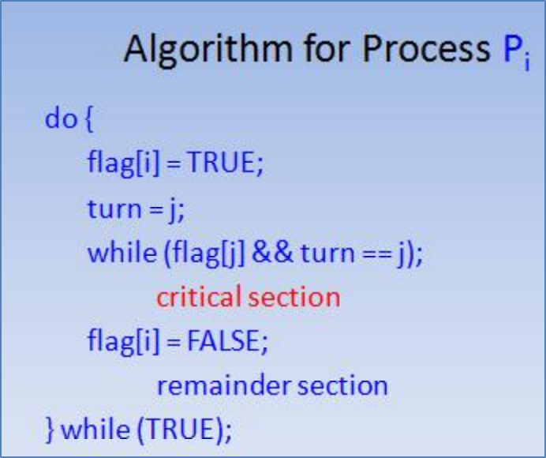
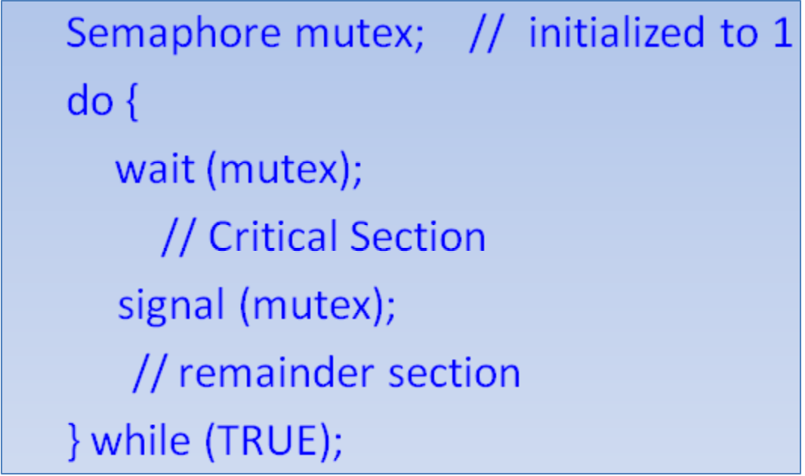
What are the solutions?
Peterson’s solution.
Semaphore
Replaced with your own text
Replaced with your own text
P Algorithem
Semaphore Mutex

Slide 4
We use Semaphore Mutex
Replaced with your own text
Replaced with your own text
For our program, using Mutex is the best choice

Slide 5
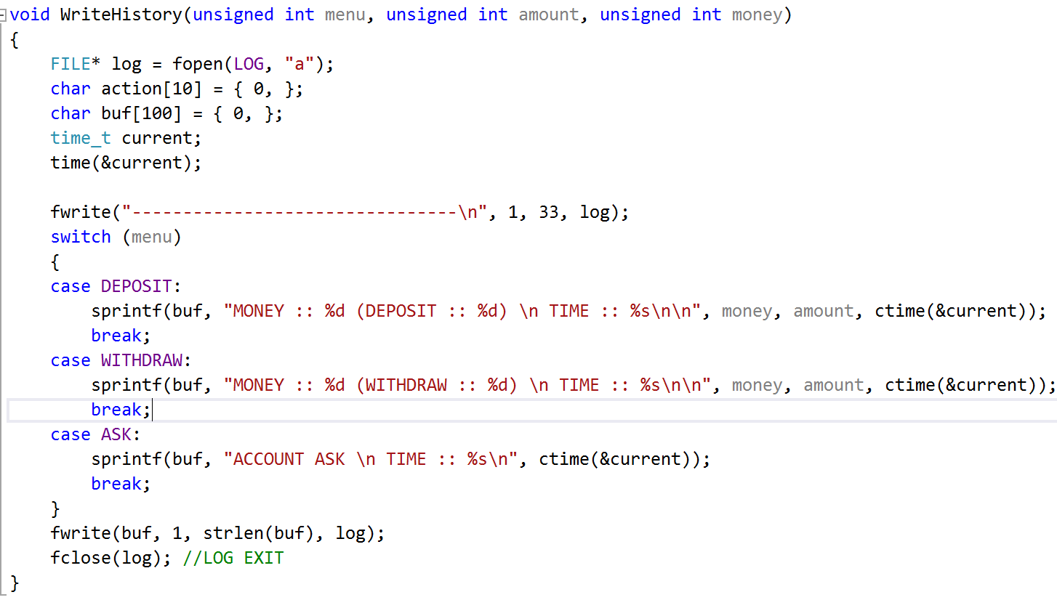
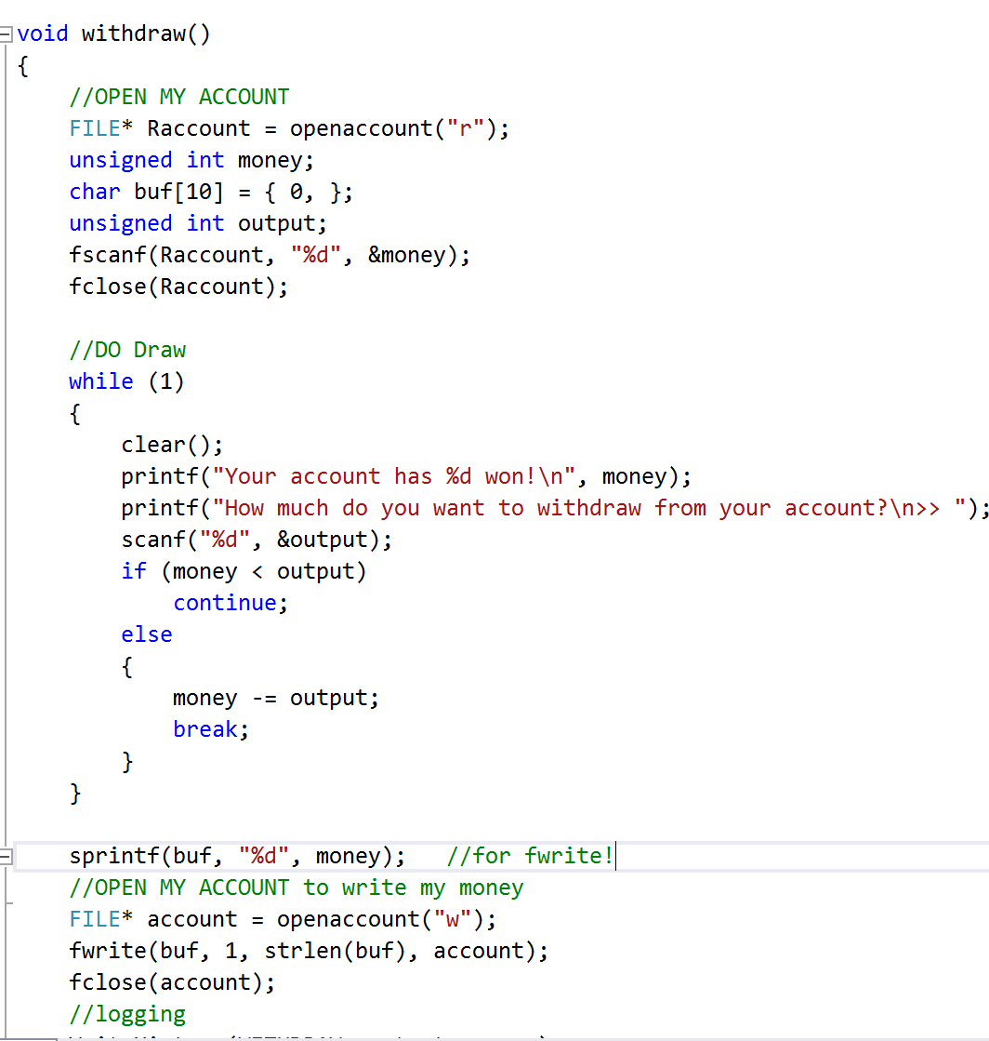
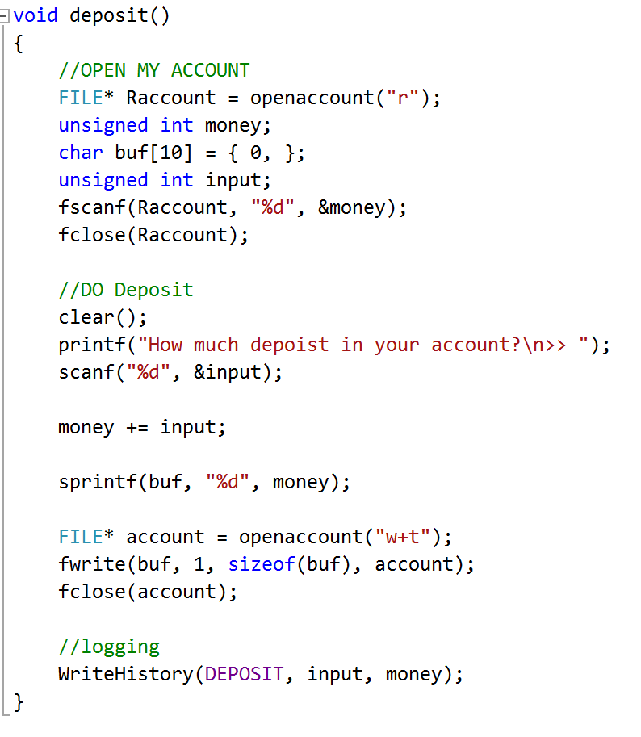
Example code

Slide 6
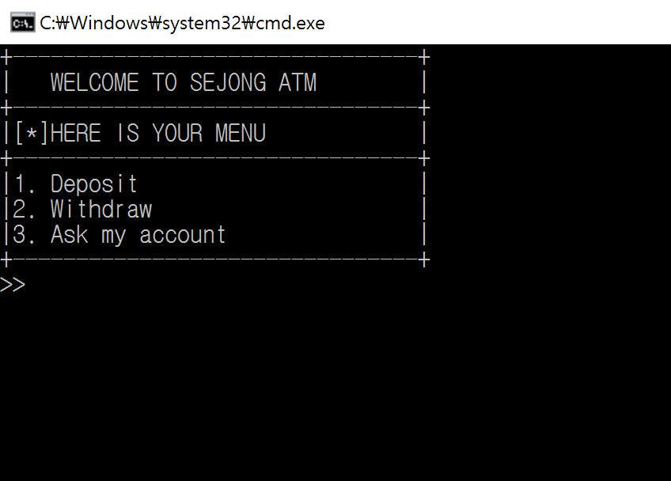
Sejong Bank

Slide 7
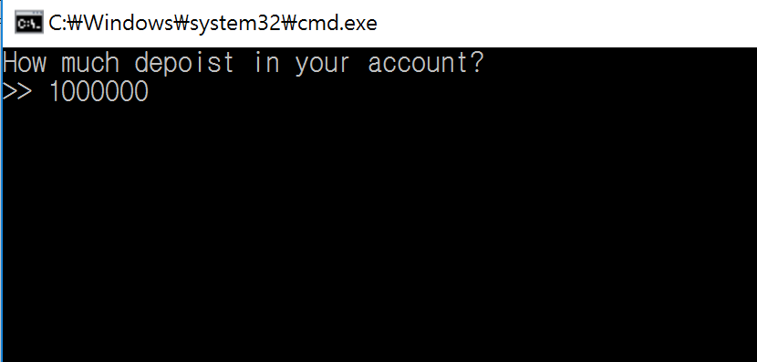
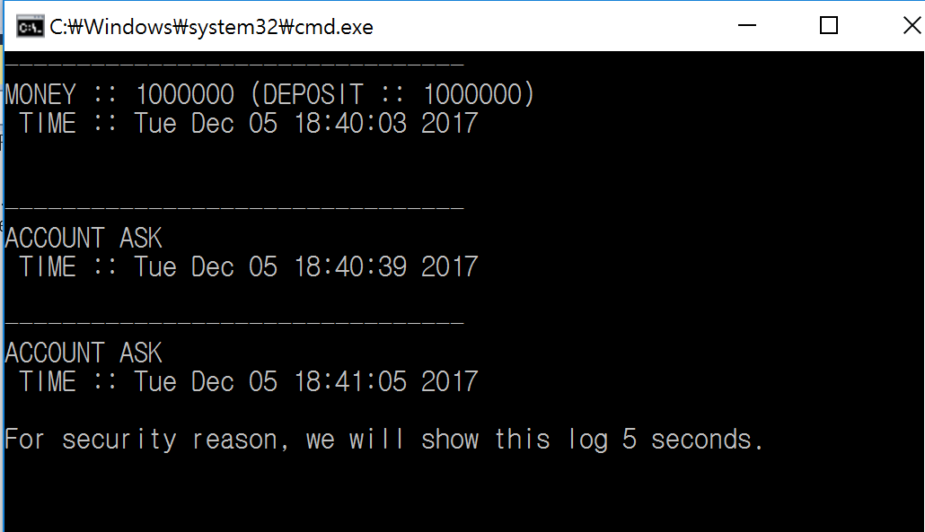
Without Mutex: After deposit

Slide 8
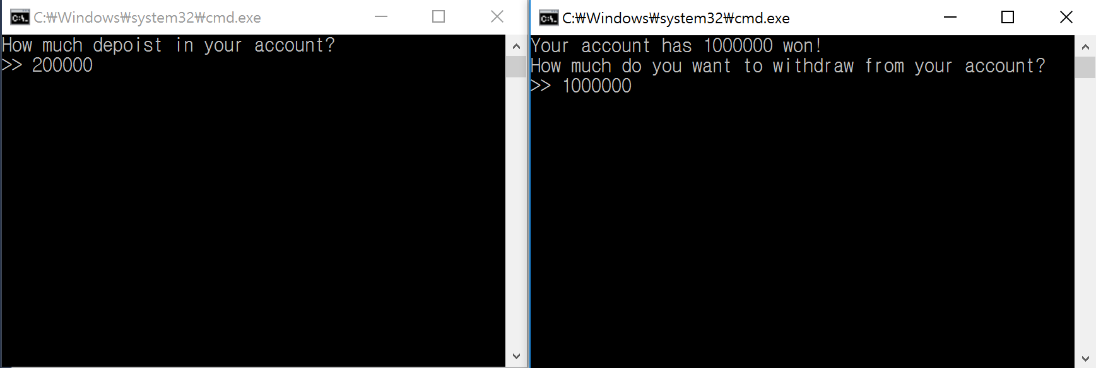
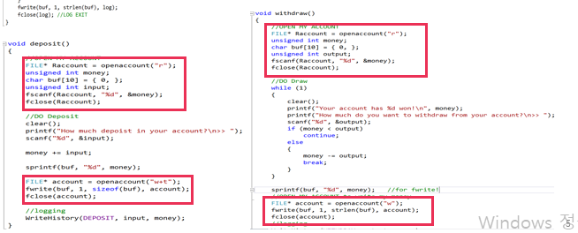
2 Programs at the same time
2
1
3
4

Slide 9
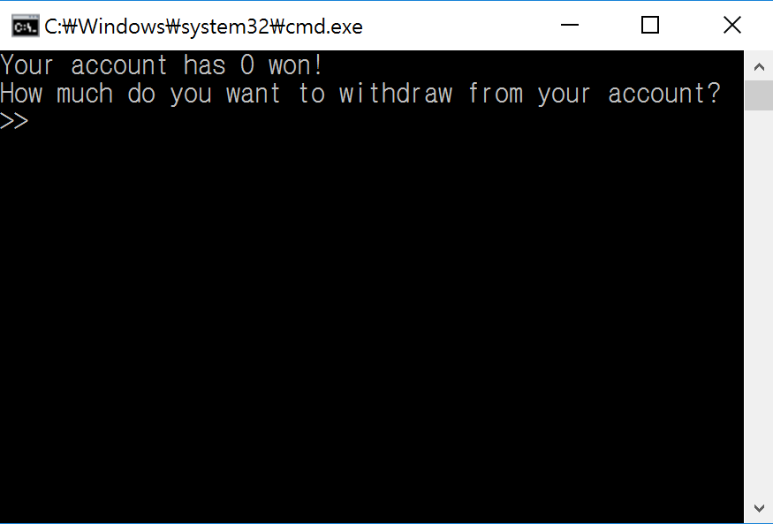
Where is the money?

Slide 10
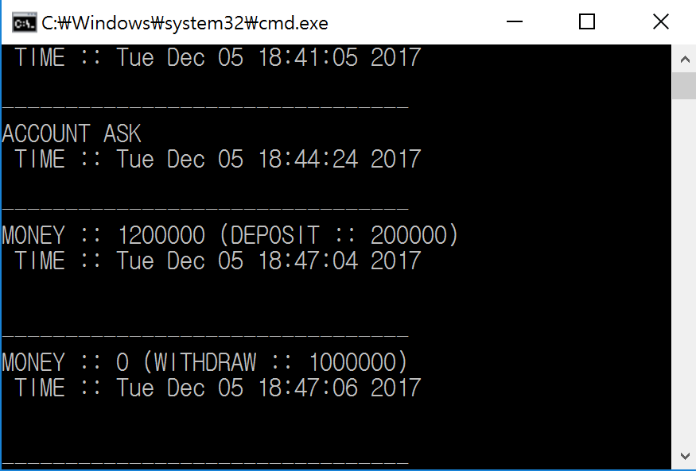
The values didn’t synchronized separately at the same time.

Slide 11
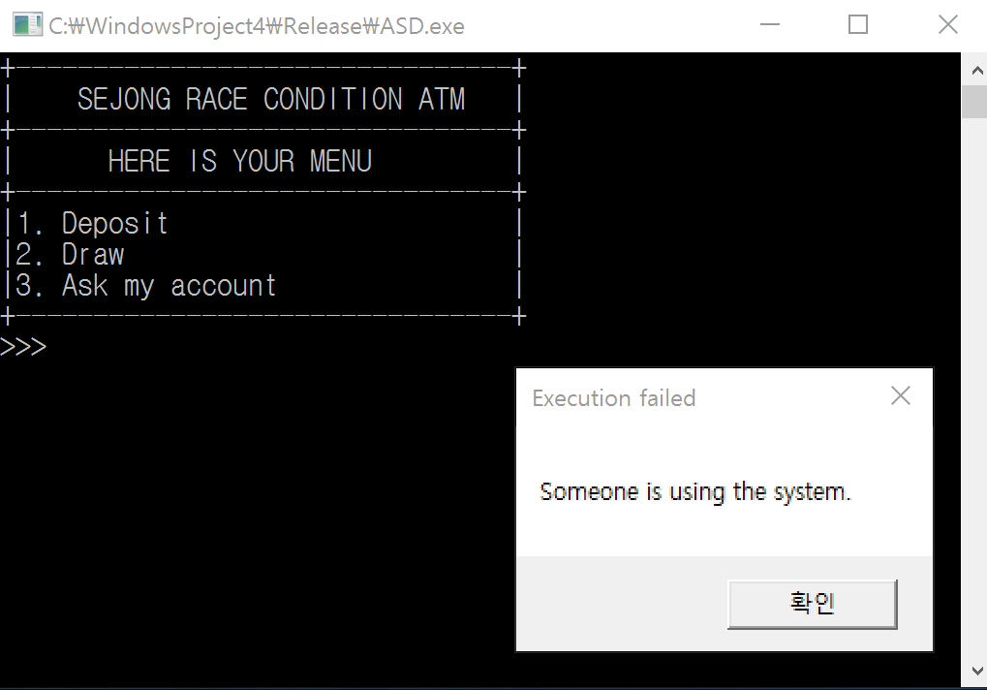
Using Mutex

Slide 12
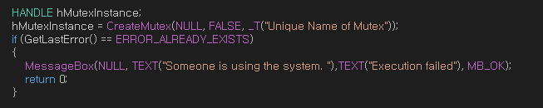
How does the Mutex work?
Only 1 program can access!

Slide 13
One more thing to do
Deadlock: Two or more processes are waiting indefinitely for an event that can be caused by only one of the waiting processes.
Starvation: Indefinite blocking. A process may never be removed from the semaphore queue in which it is suspended. .
There are 4 conditions that must occur simultaneously to cause deadlock to occur:
Mutual exclusion: only one process at a time can use a resource. Hold and wait: a process holding at least one resource is waiting to acquire additional resources held by other processes.
No preemption: a resource can be released only voluntarily by the process holding it, after that process has completed its task. Circular wait: there exists a set {P0, P1, …, P0} of waiting processes such that P0 is waiting for a resource that is held by P1, P1 is waiting for a resource that is held by P2, …, Pn–1 is waiting for a resource that is held by Pn, and Pn is waiting for a resource that is held by P0.

Slide 14
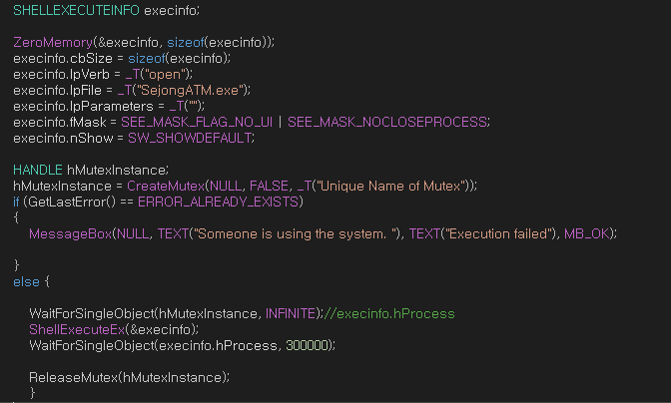
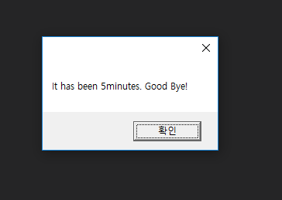

Deadlock solution
To avoid the deadlock, after 5 minutes, it automatically terminates.

Slide 15
Thank You

